Slide 1
Evaluation of Association Patterns

Slide 2
Evaluation of Association Patterns
Association analysis algorithms have the potential to generate a large number of patterns.
In real commercial databases we could easily end up with thousands or even millions of patterns, many of which might not be interesting.
Very important to establish a set of well­ accepted criteria for evaluating the quality of association patterns.
First set of criteria can be established through statistical arguments.
Second set of criteria can be established through subjective arguments.

Slide 3
Subjective Arguments
A pattern is considered subjectively uninteresting unless it reveals unexpected information about the data.
E.g., the rule {Butter} → {Bread} isn’t interesting, despite having high support and confidence values.
On the other hand, the rule {Diapers} → {Beer} is interesting because the relationship is quite unexpected and may suggest a new cross-­selling opportunity for retailers.
Drawback: Incorporating subjective knowledge into pattern evaluation is a difficult task because it requires a considerable amount of prior information from the domain experts.

Slide 4
Pattern Evaluation
Association rule algorithms tend to produce too many rules
many of them are uninteresting or redundant
Redundant if {A,B,C} → {D} and {A,B} → {D} have same support & confidence
Interestingness measures can be used to prune/rank the derived patterns
In the original formulation of association rules, support & confidence are the only measures used

Slide 5
Application of Interestingness Measure
Interestingness Measures

Slide 6
Computing Interestingness Measure
Given a rule X → Y, information needed to compute rule interestingness can be obtained from a contingency table
Contingency table for X → Y
 | Y | Y
X | f₁₁ | f₁₀ | f₁₊
X | f₀₁ | f₀₀ | f_{o+}
 | f₊₁ | f₊₀ | |T|
f₁₁: support of X and Y f₁₀: support of X and Y f₀₁: support of X and Y f₀₀: support of X and Y
Used to define various measures
support, confidence, lift, Gini, J-measure, etc.

Slide 7
Pitfall of Confidence
 | Coffee | ¬Coffee
Tea | 150 | 50 | 200
¬Tea | 650 | 150 | 800
 | 800 | 200 | 1000
The pitfall of confidence can be traced to the fact that the measure ignores the support of the itemset in the rule consequent.
Consider association rule: Tea → Coffee
Confidence=
P(Coffee,Tea)/P(Tea) = P(Coffee|Tea) = 150/200 = 0.75 (seems quite high)
But, P(Coffee) = 0.8
Thus knowing that a person is a tea drinker actually decreases his/her probability of being a coffee drinker from 80% to 75%!
Although confidence is high, rule is misleading
In fact P(Coffee|¬Tea) =
P(Coffee, ¬Tea)/P(¬Tea) = 650/800 = 0.8125

Slide 8
Interest Factor
Measure that takes into account statistical dependence
Interest factor compares the frequency of a pattern against a baseline frequency computed under the statistical independence assumption.
The baseline frequency for a pair of mutually independent variables is:
Or equivalently

Slide 9
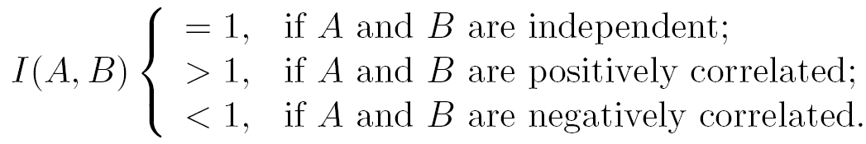
Interest Equation
Fraction f₁₁/N is an estimate for the joint probability P(A,B), while f₁₊ /N and f₊₁ /N are the estimates for P(A) and P(B), respectively.
If A and B are statistically independent, then P(A∧B)=P(A)×P(B), thus the Interest is 1.

Slide 10
Statistical Independence
Population of 1000 students
600 students know how to swim (S)
700 students know how to bike (B)
420 students know how to swim and bike (S,B)
P(S∧B) = 420/1000 = 0.42
P(S) × P(B) = 0.6 × 0.7 = 0.42
P(S|B) = P(S) ( P(S∧B)/P(B) = .42 / .7 = .6 = P(S) )
P(S∧B)/P(B) = P(S)
P(S∧B) = P(S) × P(B) => Statistical independence
P(S∧B) > P(S) × P(B) => Positively correlated
i.e. if someone knows how to swim, then it is more probable he knows how to bike, and vice versa
P(S∧B) < P(S) × P(B) => Negatively correlated
i.e. if someone knows how to swim, then it is less probable he/she knows how to bike, and vice versa

Slide 11
Example: Interest
 | Coffee | ¬Coffee
Tea | 150 | 50 | 200
¬Tea | 650 | 150 | 800
 | 800 | 200 | 1000
Association Rule: Tea → Coffee
Interest =
150*1000 / (200*800)= 0.9375
(< 1, therefore they are negatively correlated)

Slide 12
Interestingness Measure: Correlations (Lift)
play basketball ⇒ eat cereal [40%, 66.7%] is misleading
The overall % of students eating cereal is 75% > 66.7%.
play basketball ⇒ not eat cereal [20%, 33.3%] is more accurate, although with lower support and confidence
Measure of dependent/correlated events: lift
 | Basketball | Not basketball | Sum (row)
Cereal | 2000 | 1750 | 3750
Not cereal | 1000 | 250 | 1250
Sum(col.) | 3000 | 2000 | 5000

Slide 13
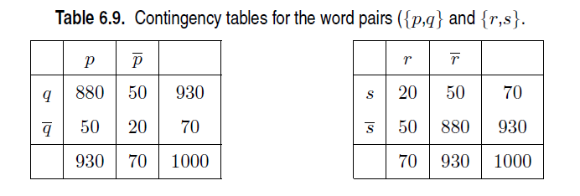
Limitations of Interest Factor

Slide 14
Drawback of Lift & Interest
 | Y | Y
X | 10 | 0 | 10
X | 0 | 90 | 90
 | 10 | 90 | 100
 | Y | Y
X | 90 | 0 | 90
X | 0 | 10 | 10
 | 90 | 10 | 100
Statistical independence:
If P(X,Y)=P(X)P(Y) => Lift = 1

Slide 15
Statistical-based Measures
Measures that take into account statistical dependence

Slide 16
Example: φ-Coefficient
φ-coefficient is analogous to correlation coefficient for continuous variables
 | Y | Y
X | 60 | 10 | 70
X | 10 | 20 | 30
 | 70 | 30 | 100
 | Y | Y
X | 20 | 10 | 30
X | 10 | 60 | 70
 | 30 | 70 | 100
φ Coefficient is the same for both tables

Slide 17
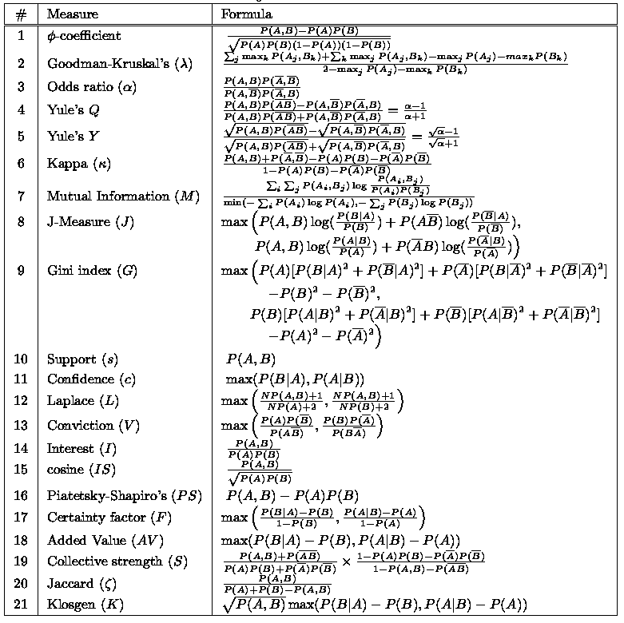
There are lots of measures proposed in the literature
Some measures are good for certain applications, but not for others
What criteria should we use to determine whether a measure is good or bad?
What about Apriori-style support based pruning? How does it affect these measures?

Slide 18
Properties of A Good Measure
Piatetsky-Shapiro (PS): 3 properties a good measure M must satisfy:
M(A,B) = 0 if A and B are statistically independent
M(A,B) increase monotonically with P(A,B) when P(A) and P(B) remain unchanged
M(A,B) decreases monotonically with P(A) [or P(B)] when P(A,B) and P(B) [or P(A)] remain unchanged

Slide 19
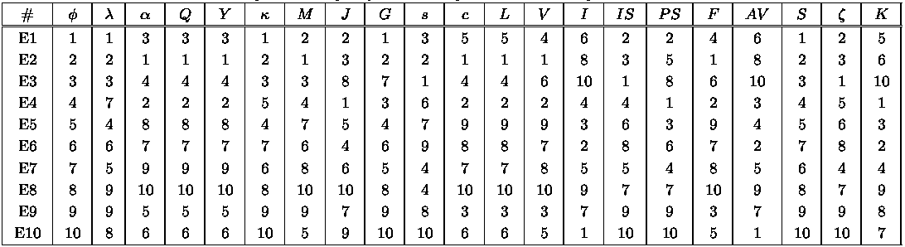
Comparing Different Measures
10 examples of contingency tables:
Rankings of contingency tables using various measures:

Slide 20
Property under Variable Permutation
Does M(A,B) = M(B,A)?
Symmetric measures:
support, lift, collective strength, cosine, Jaccard, etc
Asymmetric measures:
confidence, conviction, Laplace, J-measure, etc

Slide 23
Property under Inversion Operation
Transaction 1
.
.
.
.
.
Transaction N

Slide 24
Property under Null Addition
Invariant measures:
support, cosine, Jaccard, etc
Non-invariant measures:
correlation, Gini, mutual information, odds ratio, etc

Slide 25
Property under Row/Column Scaling
Grade-Gender Example (Mosteller, 1968):
 | Male | Female
High | 2 | 3 | 5
Low | 1 | 4 | 5
 | 3 | 7 | 10
 | Male | Female
High | 4 | 30 | 34
Low | 2 | 40 | 42
 | 6 | 70 | 76
2x
10x
Mosteller: Underlying association should be independent of the relative number of male and female students in the samples

Slide 26
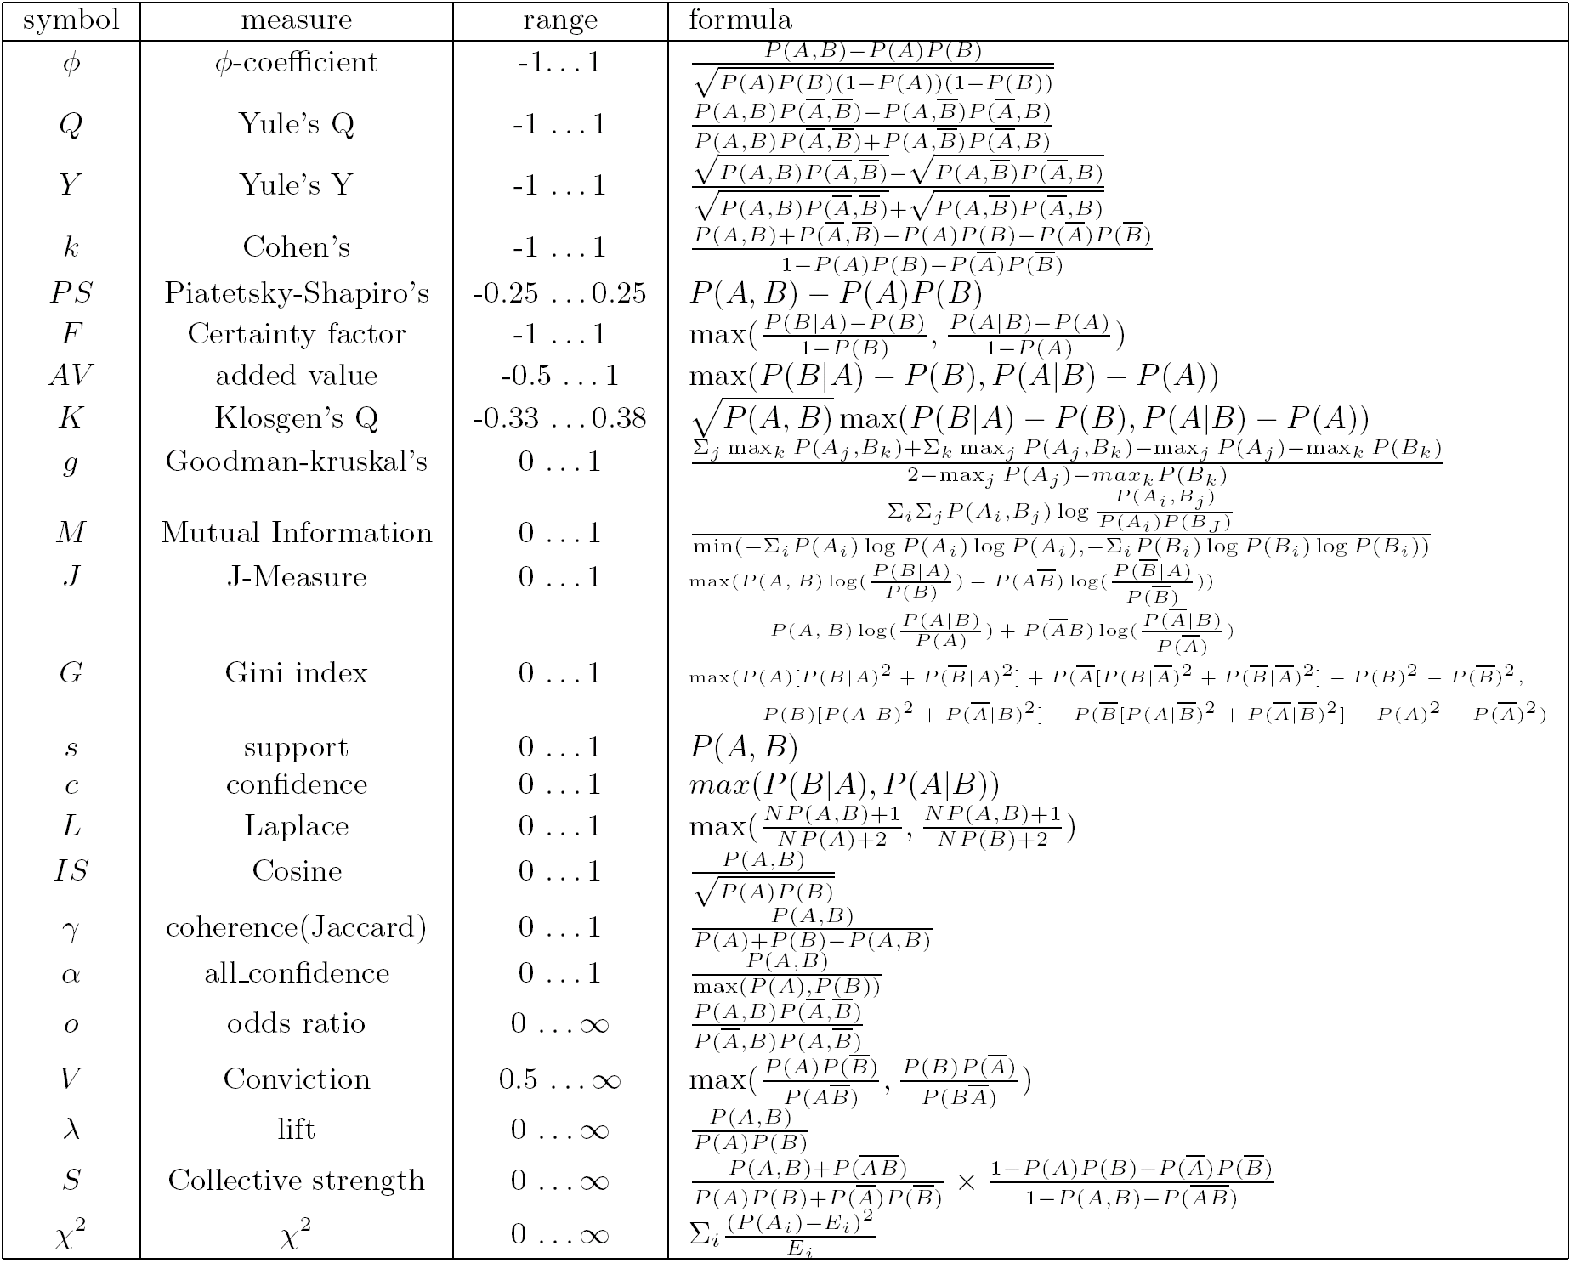
Are lift and χ² Good Measures of Correlation?
“Buy walnuts ⇒ buy milk [1%, 80%]” is misleading if 85% of customers buy milk
Support and confidence are not good to indicate correlations
Over 20 interestingness measures have been proposed (see Tan, Kumar, Sritastava @KDD’02)
Which are good ones?

Slide 27
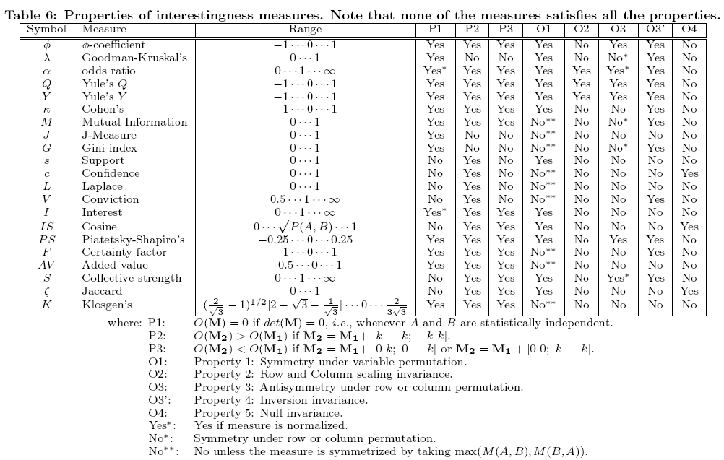
Null-Invariant Measures

Slide 28
Subjective Interestingness Measure
Objective measure:
Rank patterns based on statistics computed from data
e.g., 21 measures of association (support, confidence, Laplace, Gini, mutual information, Jaccard, etc).
Subjective measure:
Rank patterns according to user’s interpretation
A pattern is subjectively interesting if it contradicts the expectation of a user (Silberschatz & Tuzhilin)
A pattern is subjectively interesting if it is actionable (Silberschatz & Tuzhilin)

Slide 29
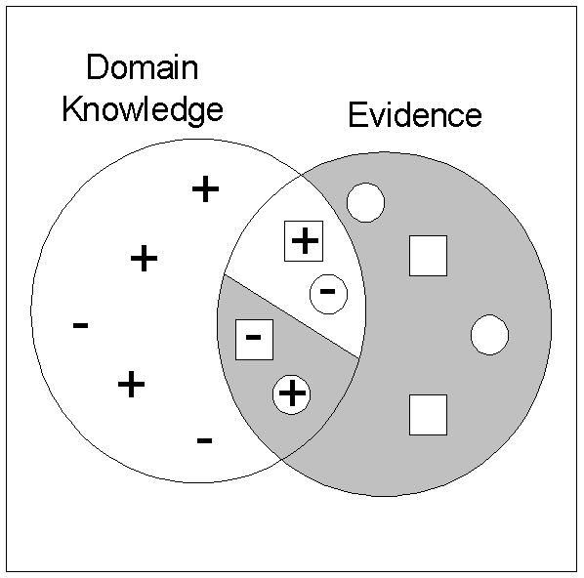
Interestingness via Unexpectedness
Need to model expectation of users (domain knowledge)
Need to combine expectation of users with evidence from data (i.e., extracted patterns)
+
Pattern expected to be frequent
-
Pattern expected to be infrequent
Pattern found to be frequent
Pattern found to be infrequent
+
-
Expected Patterns
-
+
Unexpected Patterns

Slide 30
Simpson’s Paradox

Slide 31
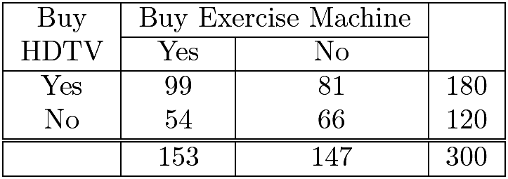
Some other example…
What’s the confidence of the following rules:
(rule 1) {HDTV=Yes} → {Exercise machine = Yes}
(rule 2) {HDTV=No} → {Exercise machine = Yes} ?
Confidence of rule 1 = 99/180 = 55%
Confidence of rule 2 = 54/120 = 45%
So, “Customers who buy high-definition televisions are more likely to buy exercise machines that those who don’t buy high-definition televisions.” Right?
Well, maybe not…

Slide 32
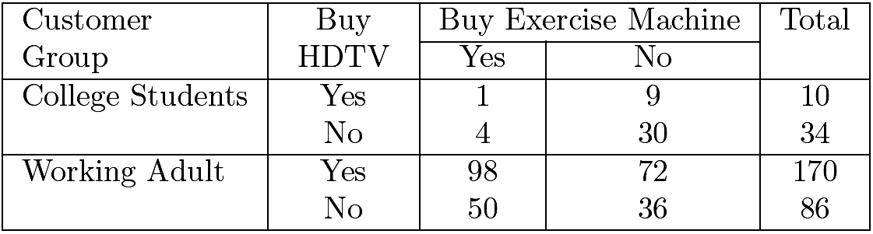
Stratification: Simpson paradox
Consider this more detailed table:
What’s the confidence of the rules for each strata:
(rule 1) {HDTV=Yes} → {Exercise machine = Yes}
(rule 2) {HDTV=No} → {Exercise machine = Yes} ?
College students:
Confidence of rule 1 = 1/10 = 10%
Confidence of rule 2 = 4/34 = 11.8%
Working Adults:
Confidence of rule 1 = 98/170 = 57.7%
Confidence of rule 2 = 50/86 = 58.1%
The rules suggest that, for each group, customers who don’t buy HDTV are more likely to buy exercise machines, which contradict the previous conclusion when data from the two customer groups are pooled together.

Slide 33
Importance of Stratification
The lesson here is that proper stratification is needed to avoid generating spurious patterns resulting from Simpson's paradox.
For example
Market basket data from a major supermarket chain should be stratified according to store locations, while
Medical records from various patients should be stratified according to confounding factors such as age and gender.

Slide 34
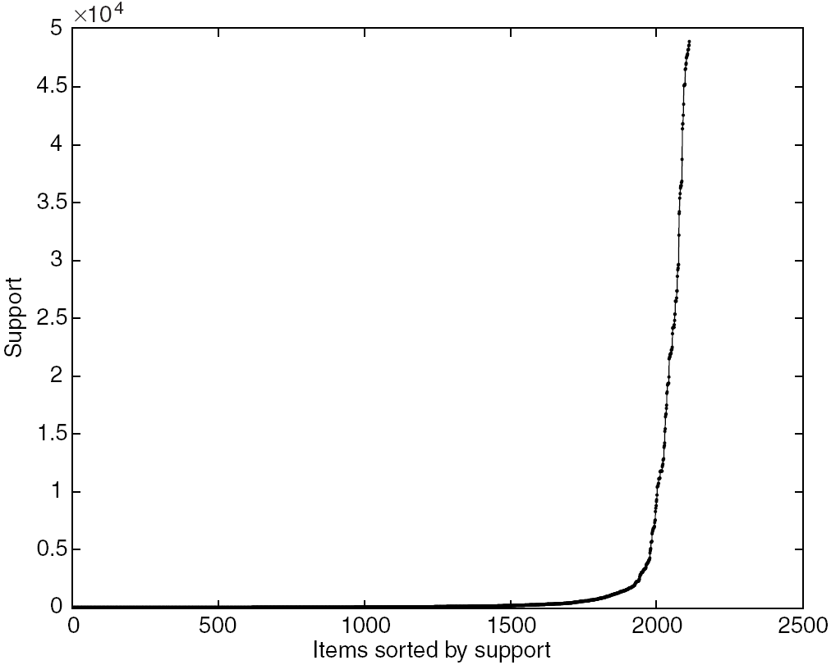
Effect of Support Distribution
Many real data sets have skewed support distribution where most of the items have relatively low to moderate frequencies, but a small number of them have very high frequencies.

Slide 35
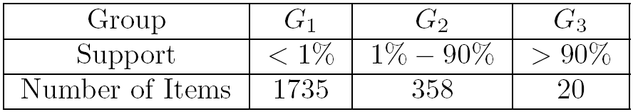
Skewed distribution
Tricky to choose the right support threshold for mining such data sets.
If we set the threshold too high (e.g., 20%), then we may miss many interesting patterns involving the low support items from G1.
Such low support items may correspond to expensive products (such as jewelry) that are seldom bought by customers, but whose patterns are still interesting to retailers.
Conversely, when the threshold is set too low, there is the risk of generating spurious patterns that relate a high ­frequency item such as milk to a low­frequency item such as caviar.

Slide 36
Summary
Basic concepts: association rules, support-confident framework, closed and max-patterns
Scalable frequent pattern mining methods
Apriori (Candidate generation & test)
Projection-based (FPgrowth, CLOSET+, ...)
Which patterns are interesting?
Pattern evaluation methods

